Slide 1
Mapping
the DNA
of a
Healthy
Small
Church

Slide 2
The 200churches Story Jeff & Jonny
200churches.com – The 200churches Podcast
Ministry Encouragement for Pastors of Small Churches

Slide 3
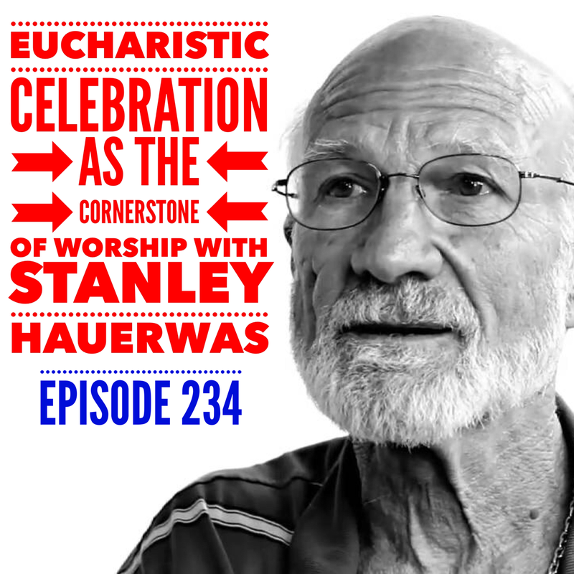
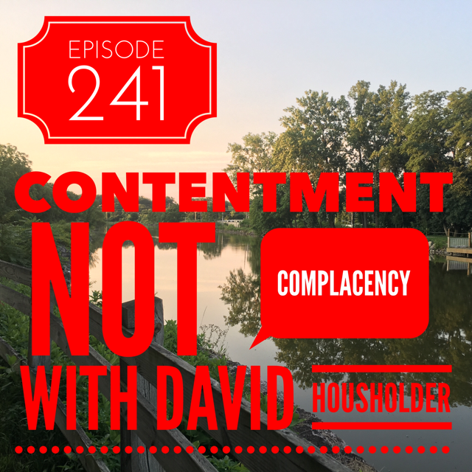
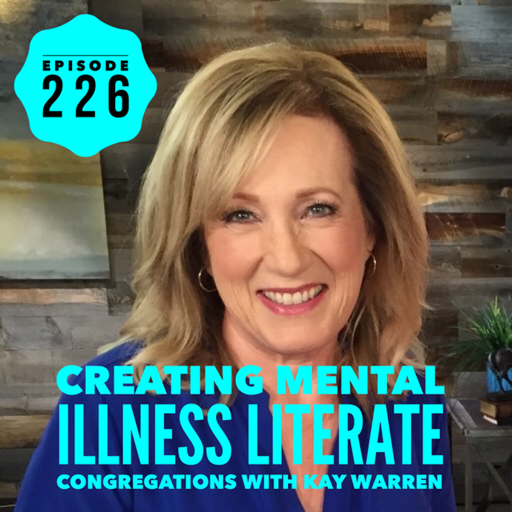
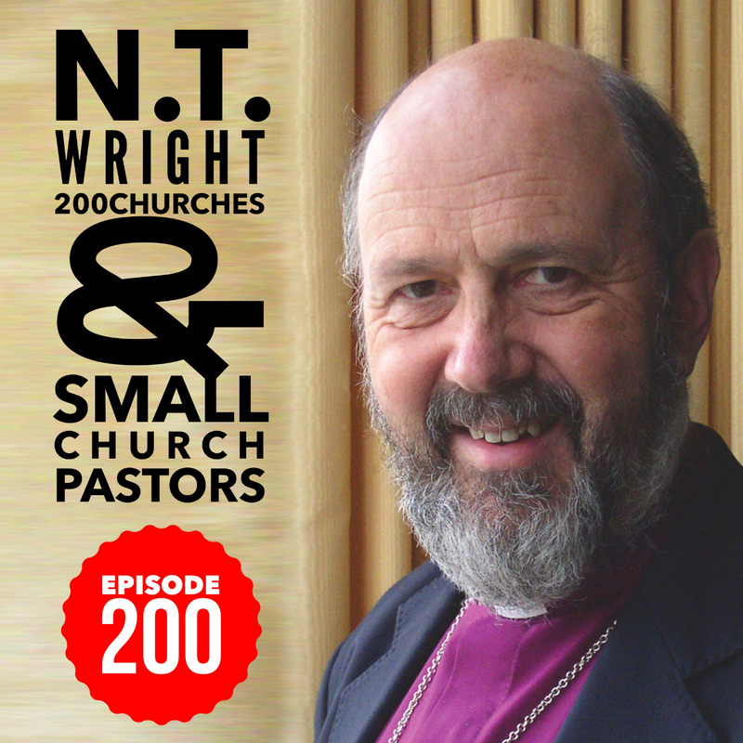
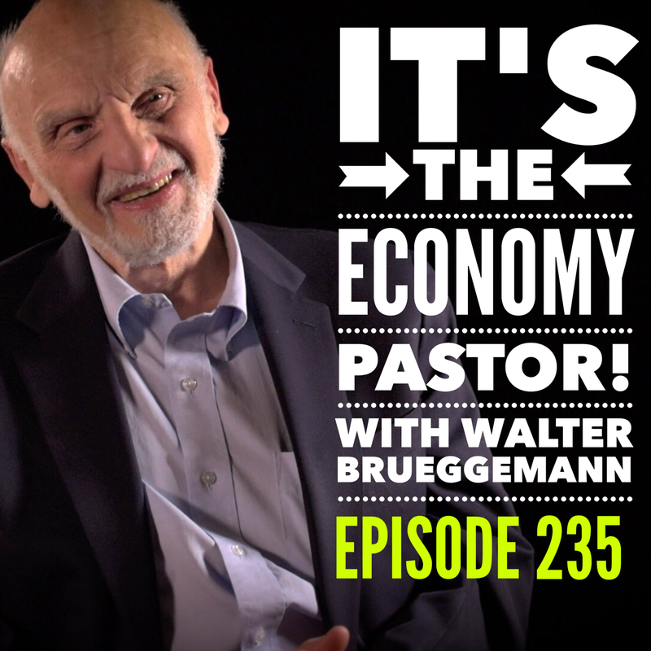

Slide 4
Small churches are to be valued, celebrated, and affirmed!

Slide 5
“All healthy things grow”
So, what’s wrong with your church?!

Slide 6
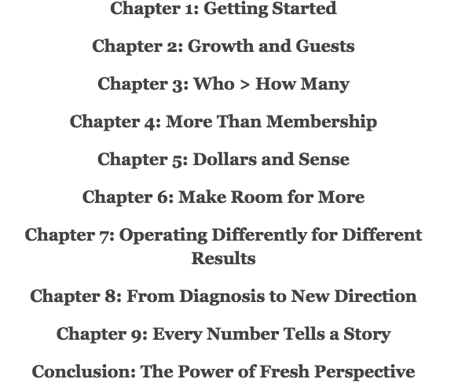
Vital Signs:
Why Church Health Matters and 14 Ways to Measure It

Slide 7
Simple Church
Deep & Wide
Sticky Church
Purpose Driven Church
Emotionally Healthy Church
Natural Church Development

Slide 8
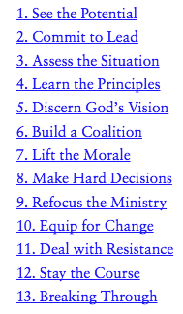
There's Hope for Your Church: First Steps to Restoring Health and Growth

Slide 9
We think there’s a better way.

Slide 10
What if God has a better plan?

Slide 11
Matthew 22:34-40
34 Hearing that Jesus had silenced the Sadducees, the Pharisees got together. 35 One of them, an expert in the law, tested him with this question:
36 “Teacher, which is the greatest commandment in the Law?”
37 Jesus replied: “ ‘Love the Lord your God with all your heart and with all your soul and with all your mind.’ 38 This is the first and greatest commandment. 39 And the second is like it: ‘Love your neighbor as yourself.’ 40 All the Law and the Prophets hang on these two commandments.”

Slide 12
Galatians 5:6,13,14,22
6 For in Christ Jesus neither circumcision nor uncircumcision has any value. The only thing that counts is faith expressing itself through love.
13 You, my brothers and sisters, were called to be free. But do not use your freedom to indulge the flesh; rather, serve one another humbly in love. 14 For the entire law is fulfilled in keeping this one command: “Love your neighbor as yourself.”
22 But the fruit of the Spirit is love…

Slide 13
Romans 13:8-10
8 Let no debt remain outstanding, except the continuing debt to love one another, for whoever loves others has fulfilled the law.
9 The commandments, “You shall not commit adultery,” “You shall not murder,” “You shall not steal,” “You shall not covet,” and whatever other command there may be, are summed up in this one command: “Love your neighbor as yourself.”
10 Love does no harm to a neighbor. Therefore love is the fulfillment of the law.

Slide 14
Ecclesiastes 12:13
Now all has been heard;
here is the conclusion of the matter:
Fear God and keep his commandments,
for this is the duty of all mankind.

Slide 15
Ecclesiastes 12:13
Now all has been heard;
here is the conclusion of the matter:
Fear God and keep his commandments,
for this is the duty of all mankind.
John 13:35
34 “A new command I give you: Love one another. As I have loved you, so you must love one another. 35 By this everyone will know that you are my disciples, if you love one another.”

Slide 16
L
O
V
E

Slide 17
RELATIONSHIPS

Slide 18
RELATIONSHIPS
SERVICE

Slide 19
RELATIONSHIPS
SERVICE
WORSHIP

Slide 20
GROWTH
RELATIONSHIPS
SERVICE
WORSHIP

Slide 21
OUTREACH
GROWTH
RELATIONSHIPS
SERVICE
WORSHIP

Slide 22
OUTREACH
GROWTH
RELATIONSHIPS
SERVICE
WORSHIP
L
O
V
E

Slide 23
MATURING
OUTREACH
GROWTH
RELATIONSHIPS
SERVICE
WORSHIP
L
O
V
E

Slide 24
MATURING
Outcome
OUTREACH
GROWTH
Results
RELATIONSHIPS
SERVICE
WORSHIP
Practices
L
O
V
E
Purpose

Slide 25
MATURING
God
Does
this
OUTREACH
GROWTH
RELATIONSHIPS
SERVICE
WORSHIP
We
Do
this
L
O
V
E

Slide 26
MATURING
God’s
Focus
OUTREACH
GROWTH
RELATIONSHIPS
SERVICE
WORSHIP
Our Focus
L
O
V
E

Slide 27
Hidden in plain sight

Slide 28
The ANTIBOXES!

Slide 30
S
E
L
F

Slide 31
NETWORK
S
E
L
F

Slide 32
NETWORK
IMAGE
S
E
L
F

Slide 33
NETWORK
IMAGE
WORKS
S
E
L
F

Slide 34
SUCCESS
NETWORK
IMAGE
WORKS
S
E
L
F

Slide 35
REPUTATION
SUCCESS
NETWORK
IMAGE
WORKS
S
E
L
F

Slide 36
STATUS
REPUTATION
SUCCESS
NETWORK
IMAGE
WORKS
S
E
L
F

Slide 37
STATUS
Outcome
REPUTATION
SUCCESS
Goals
NETWORK
IMAGE
WORKS
Strategy
S
E
L
F
Motivation

Slide 38
MATURING
OUTREACH
GROWTH
RELATIONSHIPS
SERVICE
WORSHIP
L
O
V
E

Slide 39
MATURING
Outcome
OUTREACH
GROWTH
Results
RELATIONSHIPS
SERVICE
WORSHIP
Practices
L
O
V
E
Purpose

Slide 40
every person in your church lives either out of love or out of self
motivated by love or motivated by self
the more your church family is motivated by love and not self, and the more they follow Jesus’ two greatest commandments, the healthier your church is
it is no more simple, and no more complex than that
when your people hear the truth about a healthy church, they will say, “oh! well that’s pretty simple! we can do that! we thought we had to know everything about the Bible and obey all the commandments!”

